Slide 1
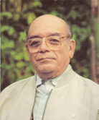
jTatic Samuel Ruiz

